Slide 1
Node Js Sever Design Principles
By Abhilash Thota

Slide 2
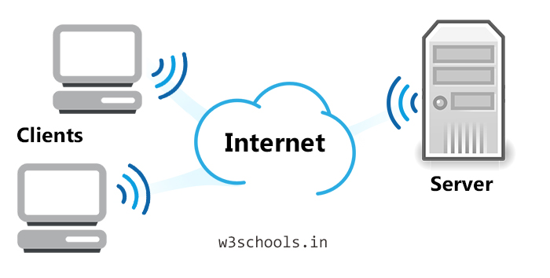
What is a Server
A server is a computer program designed to process requests and deliver data to another computer (client) over the internet or a local network.
What do servers do -
Render / serve Web pages.
Receive/send Emails(SMTP).
Transfer files (FTP).
Provide data (xml, json, pictures, videos).
Perform computations. (ML, Data Analytics etc.)
Real time communication(chat, screensharing etc.)
Some servers exist for a specific purpose but aren't necessarily interacted with in any meaningful way. DNS servers and proxy servers are some examples.

Slide 3
How do client and server communicate
Request–response, or request–reply, is one of the basic methods computers use to communicate with each other, in which the first computer sends a request for some data and the second responds to the request.
Clients can send http requests to resources on a server to perform various operations. The primary and most used types of requests are POST, GET, PUT, PATCH, and DELETE.
The Server also sends a Status Code (200,404,500 etc.) to help the client handle the server's response.

Slide 4
What is Node JS
Node.js is an open-source and cross-platform JavaScript runtime environment. It is a popular tool for almost any kind of project!
Node.js runs the V8 JavaScript engine, the core of Google Chrome, outside of the browser. This allows Node.js to be very performant.
Node.js came into existence when the original developers of JavaScript extended it from something you could only run in the browser to something you could run on your machine as a standalone application.

Slide 5
Why use Node JS
One of the primary benefits of using Node JS is using JavaScript across the stack unifies the language and data format (JSON), allowing you to optimally reuse developer resources.
Uses non-blocking, event-driven I/O to remain lightweight and efficient in the face of data-intensive real-time applications.
When not to use Node.js is for CPU-intensive operations; in fact, using it for heavy computation will annul nearly all of its advantages.
Where Node really shines is in building fast, scalable network applications, as it’s capable of handling a huge number of simultaneous connections with high throughput, which equates to high scalability.

Slide 6
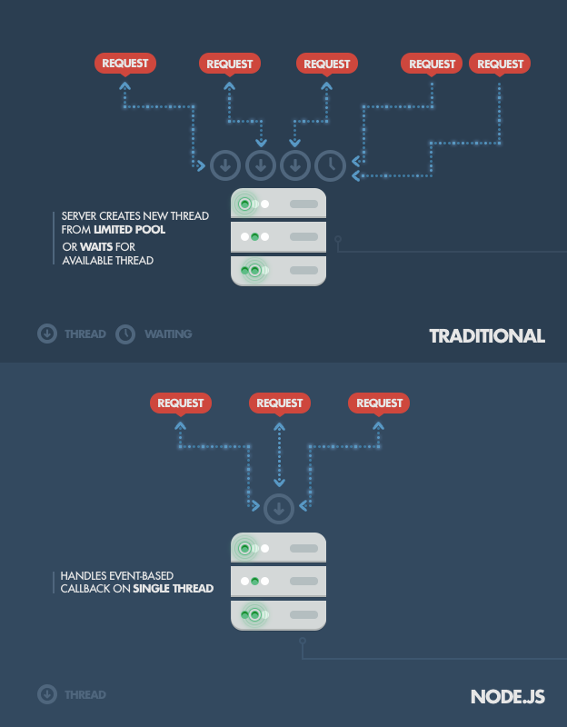
How Node JS works
Compared to traditional web-serving techniques where each connection (request) spawns a new thread, taking up system RAM and eventually maxing-out at the amount of RAM available, Node.js operates on a single-thread, using non-blocking I/O calls, allowing it to support tens of thousands of concurrent connections held in the event loop.

Slide 7
Example of Blocking vs Non-Blocking
//Blocking code
console.log("Getting Data1"); var data1 = getData('123'); console.log("Data is:", data1); console.log("Getting Data2"); var data2 = getData('456'); console.log("Data is:", data2); var sum = 1 + 2; console.log("sum is:", sum);
// Non-Blocking code
console.log("Getting Data1"); getData('123', function(data1) { console.log("Data is:", data1); }); console.log("Getting Data2"); getData('456', function(data1) { console.log("Data is:", data1); }); var sum = 1 + 2; console.log("sum is:", sum);

Slide 8
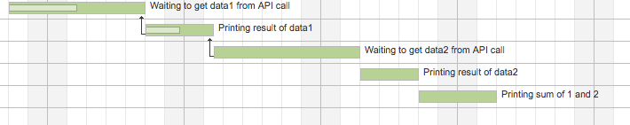
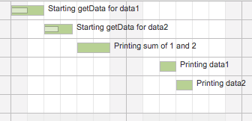
Code Execution
Blocking code
Non-Blocking Code

Slide 9
Non Blocking example
Server Code :
async function billing(req,res){
console.log("function start");
var items = [];
for (let item of req.body.cart){
let itemPromise = db.Items.findOne({_id : item.id});
ItemPromise.then((item)=>{
console.log("item retreived");
items.push(item);
})
}
var bill = new db.Billing({...}) ;
// calculate bill (skipping)
// bill item is filled with billing data;
bill.save().then((result)=>{
Console.log("bill entry saved in db");
});
res.send(bill);
}
Add items to a shopping cart -> Click Checkout -> Site / App displays bill.
The Frontend(app/site) sends the cart data to the server.
The Server Retrieves data of each item from db (I/O operation) - don’t wait.
Server creates Billing Entry object - don’t wait.
Wait till item data retrieval is complete. Then calculate taxes, discount etc., and fill the data in billing object - wait.
Save the billing object in db (I/O operation) - don’t wait.
Send response to client.

Slide 10
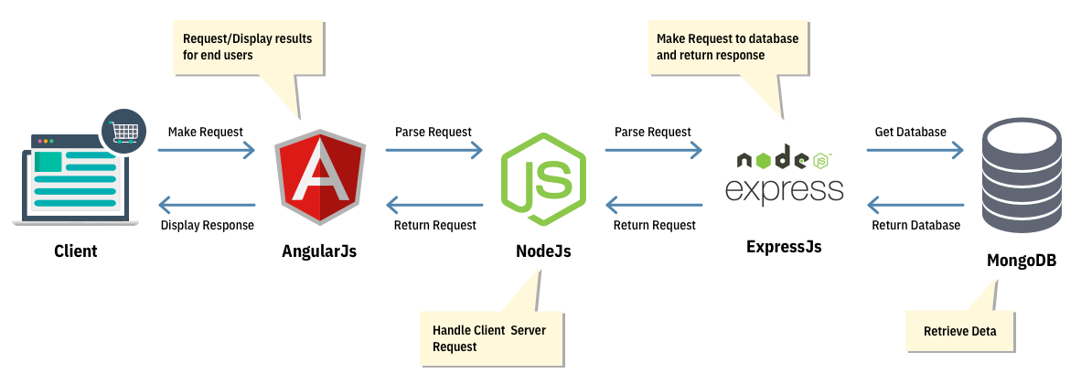
How to design a Full Stack (MEAN)
MEAN stands for – Mongo, Express, Angular, Node

Slide 11
Why use MongoDB ?
MongoDB is an object-oriented, simple, dynamic, and scalable NoSQL database. It is based on the NoSQL document store model.
MongoDB represents the data as a collection of documents rather than tables related by foreign keys.
For example if your application has relatively small audience plus you don't need sub 1ms latency of requests.
Easy to setup and use - It is ideal for startups where only one full-stack JavaScript developer can run the whole service from the ground up. You don't need sysadmins, SQL developers, back-end developers. Just one guy can do everything and can do it fast.

Slide 12
How to setup the Backend ?
Structure – Needed to make code Organized, Reusabile, Understandabile.
Pacakage file – Includes the metadata and dependancies of the project
allowing for easier setup of the project.
Models - to store database schema.
Routes - contains controllers which define the backend api endpoints.
Services - contains the functions which execute backend functionality
Utils – to store utility function which are reused in multiple services.

Slide 13
Thank You
Hope you had a good time learning about Node. Keep Coding.

